Slide 1


What's It Like To Work in the WS-DL Lab?
Michele C. Weigle and Michael L. Nelson
CS 891 – Web Archiving Seminar
Fall 2017
@WebSciDL
https://phonedude.github.io/cs891-f17/

Slide 2
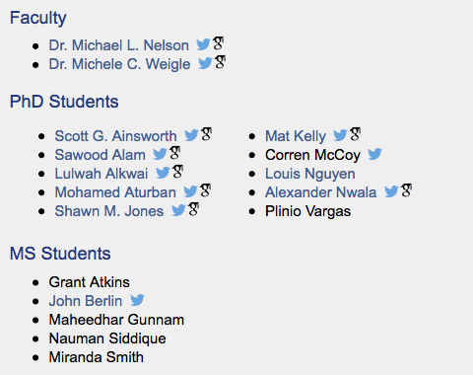
People in WS-DL
https://ws-dl.cs.odu.edu/Main/People

Slide 3
Working in the WS-DL Lab
Dr. Nelson and I co-advise most of the students in the lab.
Taking one of our graduate courses, and doing well, is a prerequisite for being our students.
that's why some of you are in this class – good job!
You are judged in the real world by results not effort.
Just working long hours won't get you a PhD (or even a paper published)
If you deliver, then we don't care how much, where, or when you work
BUT, you would greatly benefit from working in the lab as much as possible when others are around
Inspired by https://www.cs.ubc.ca/~tmm/policy.txt

Slide 4
Working in the WS-DL Lab
We expect you to work hard.
Research is a game where you're directly competing with lots of other people who are just as smart as you are, and many of them are working very hard.
Remember where GRAs come from…
But, you should also take some vacation.
appropriately timed, of course
Inspired by https://www.cs.ubc.ca/~tmm/policy.txt

Slide 5
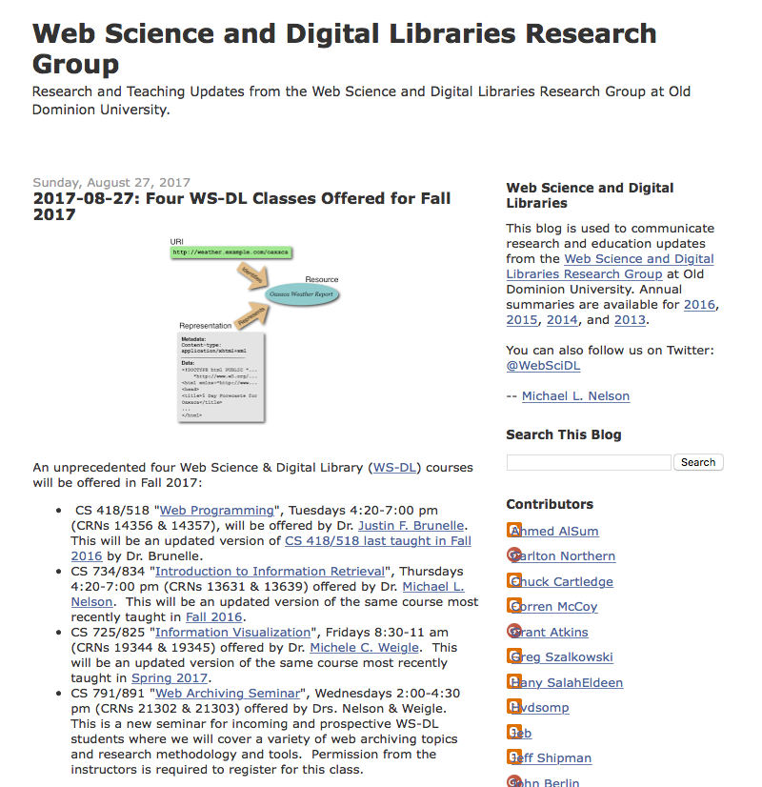
Read the WS-DL Blog
http://ws-dl.blogspot.com/

Slide 6
Read the WS-DL Blog
Trip reports
cool research that has been presented at conferences
names of other researchers in the area
Small tidbits of research or useful tools
not quite enough for a paper, but enough to share
WS-DL software releases
Paper summaries

Slide 7
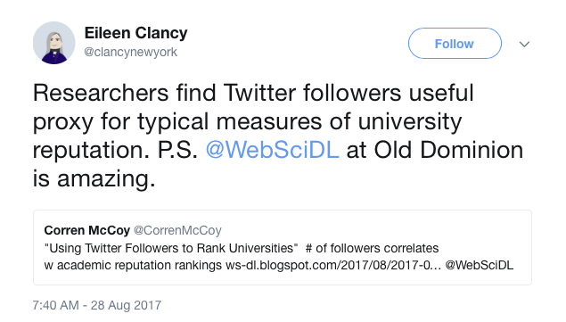
Engage on Twitter
Twitter is a professional development tool
Important people in our field use this for communication
When you write a post for the WS-DL blog, you will tweet a link to it
https://twitter.com/clancynewyork/status/902133825110671360

Slide 8
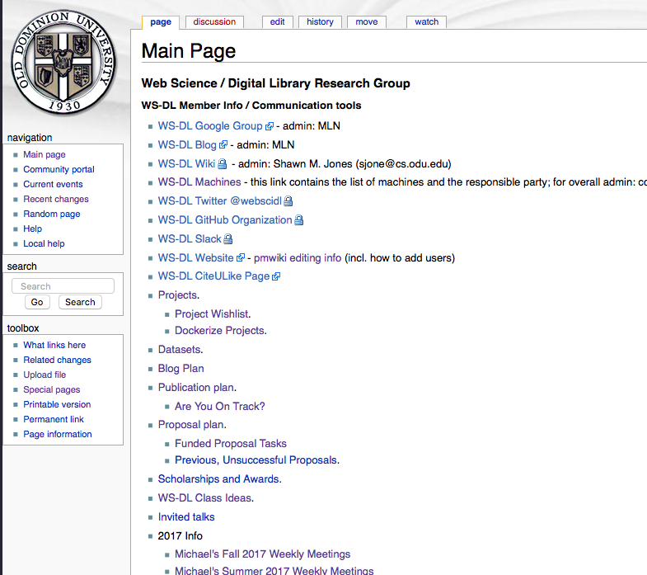
WS-DL Wiki - The Main Page is Useful…
https://ws-dl.cs.odu.edu/wiki/index.php/Main_Page

Slide 9
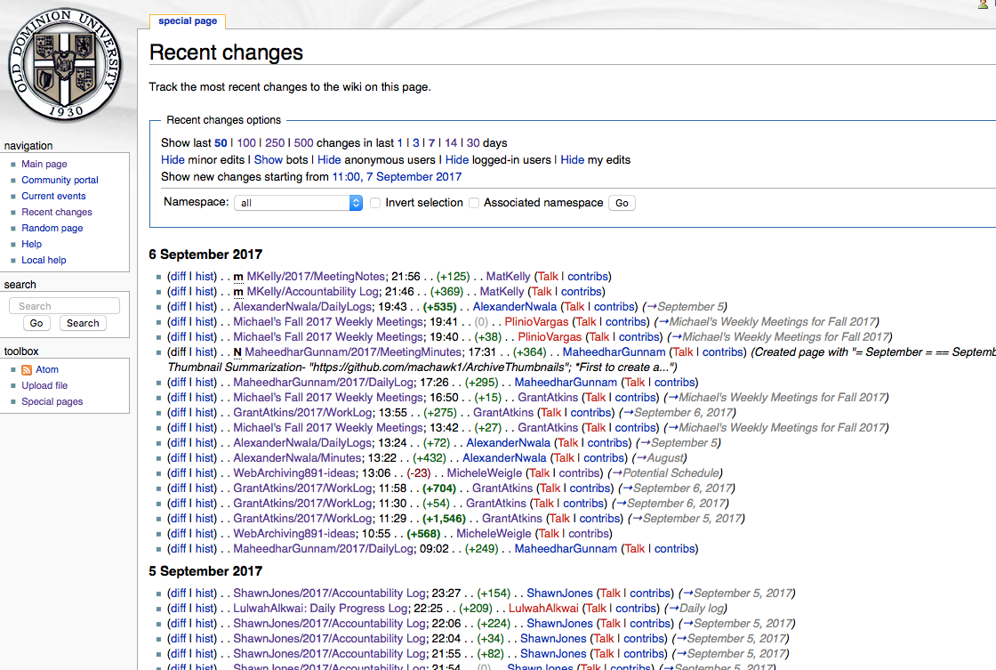
But, Recent Changes is the Key

Slide 10
Embrace the WS-DL Wiki - For Yourself
Keep a daily log
easiest to put new stuff at the top
Keep notes while you're working
Read other students' updates

Slide 11
Embrace the WS-DL Wiki - For Your Aging Advisors
Post a summary of your work to discuss during meetings
if you want to show us something, put it on the wiki before the meeting -- "no magic laptops"
if you tell us that you got an odd result or something went wrong, we're going to ask to see an example – put it on the wiki before the meeting
Post meeting notes
there will be lots of brilliant things said during your meetings with me and Dr. Nelson – we will not remember them

Slide 12
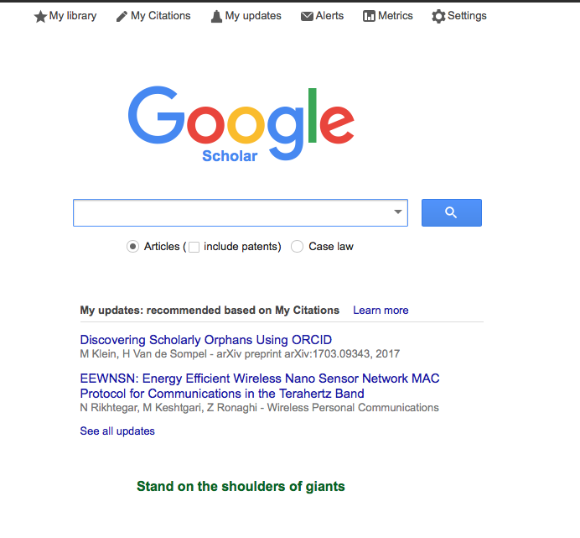
Google Scholar Is Your Friend
https://scholar.google.com
Search for papers
Find citations
Get recommendations
Keep track of your own publications

Slide 13
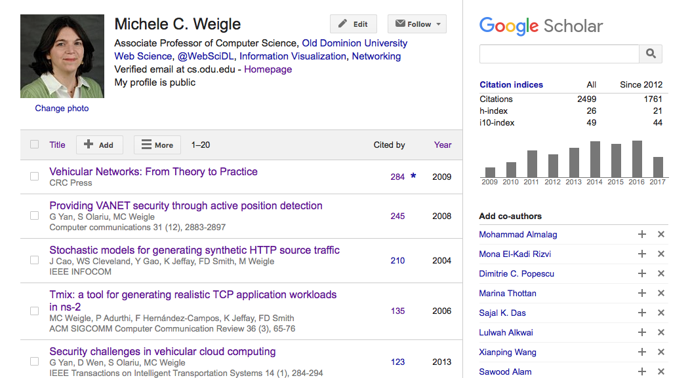
Tracking Citations
https://scholar.google.com/citations?hl=en&user=MOLPTqcAAAAJ

Slide 14
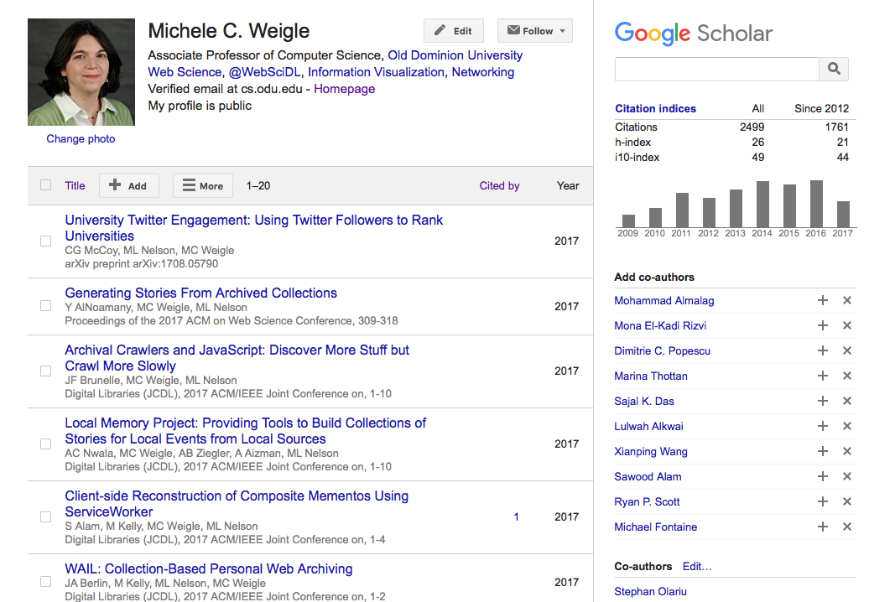
Tracking Publications – sort by year

Slide 15
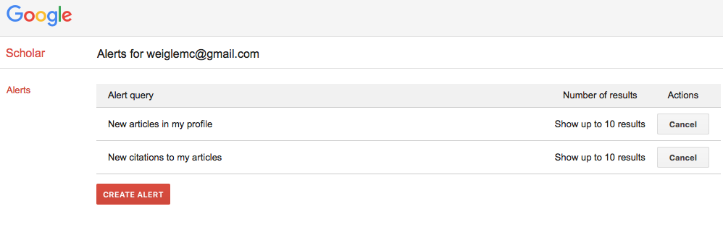
Create a Scholar Account
Make it public
Sign up for alerts
While you're at it, sign up for an ORCID
https://orcid.org

Slide 16
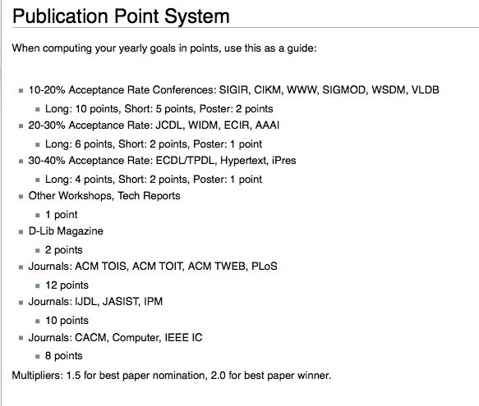
WS-DL Publication Points
https://ws-dl.cs.odu.edu/wiki/index.php/Publication_Point_System

Slide 17
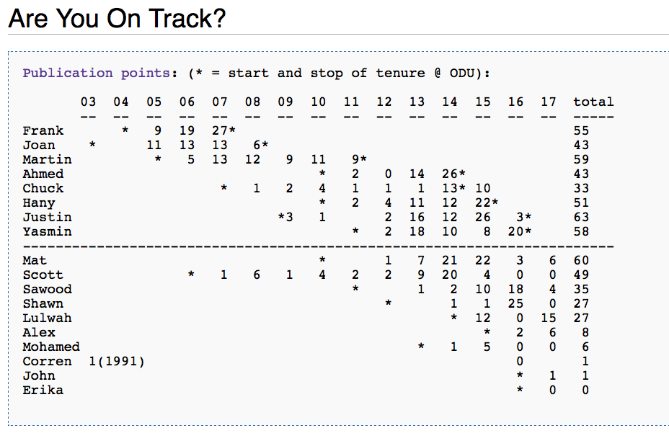
Tracking Progress - Publishing
https://ws-dl.cs.odu.edu/wiki/index.php/Are_You_On_Track%3F

Slide 18
Tracking Progress – PhD Crush

